Slide 1



BANGABANDHU SHEIKH MUJIBUR RAHMAN DIGITAL UNIVERSITY
HTTP Protocol
BY: MONIRUZZAMAN HEMAL

Slide 2

Presentation Outline
POINTS OF DISCUSSION
Web and HTTP?
ObjectivesHow HTTP works?
HTTP client server communication
HTTP request and response
Persistent and Non-persistent method

Slide 3













THE WEB
Internet (or The Web) is a massive distributed client/server information system
Internet
(The Web)
Many applications are running concurrently over the Web, such as web browsing/surfing, e-mail, file transfer, audio & video streaming, and so on. In order for proper communication to take place between the client and the server, these applications must agree on a specific application-level protocol such as HTTP, FTP, SMTP, POP, and etc.

Slide 4


THE HTTP PROTOCOL
HTTP (Hypertext Transfer Protocol) is perhaps the most popular application protocol used in the Internet (or The WEB).
HTTP= Hypertext Transfer Protocol
HTTP is an application-layer protocol for transmitting hypermedia documents, such as HTML.
HTTP is a client-server protocol by which two machines communicate using a reliable, connectionless transport service such as the TCP.
HTTP is used for transferring information like document, file, image, video between computers over internet.

Slide 5

The Basic Features of HTTP
HTTP is media independent:
Any type of media content can be sent by HTTP as long as both the server and the client can handle the data content.
HTTP is connectionless:
A browser initiates the HTTP request and after the request is sent the client disconnects from server and waits for the response.
HTTP is stateless:
The client and server are aware of each other during a current request only. Afterwards, both of them forget each other. Due to the stateless nature of protocol, neither the client nor the server can retain the information about different request across the web pages.

Slide 6







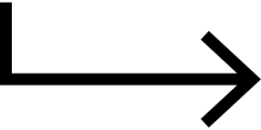
HOST(BROWSER)
TARGET(SERVER)
APPLICATION LAYER (HTTP)
APPLICATION LAYER (HTTP)
TRANSPORT LAYER (TCP)
TRANSPORT LAYER (TCP)
NETWORK LAYER (IP)
NETWORK LAYER (IP)
INTERNET
DATA LINK LAYER
DATA LINK LAYER

Slide 7





HTTP
HTTP Request
client
HTTP Response
server

Slide 8


HTTP & DNS
www.amazon.com
DNS server
Provides IP: 10.1.0.1
MAKES HTTP REQUEST
HTTP RESPONSE
TARGET SERVER
USER WITH WEB BROWSER
amazon.com

Slide 9
Uniform Resource Locator (URL)
A URL is used to uniquely identify a resource over the web. URL has the following syntax:
protocol://hostname:port/path-and-file-name
There are 4 parts in a URL:
Protocol: The application-level protocol used by the client and server, e.g., HTTP, FTP, and telnet.
Hostname: The DNS domain name (e.g., www.nowhere123.com) or IP address (e.g., 192.128.1.2) of the server.
Port: The TCP port number that the server is listening for incoming requests from the clients.
Path-and-file-name: The name and location of the requested resource, under the server document base directory.

Slide 10

For example, in the URL
http://www.nowhere123.com/docs/index.html
The communication protocol is HTTP;
The hostname is www.nowhere123.com.
The port number was not specified in the URL, and takes on the default number, which is TCP port 80 for HTTP.
The path and file name for the resource to be located is "/docs/index.html".

Slide 11

When this request message reaches the server, the server can take either one of these actions:
The server interprets the request received, maps the request into a file under the server's document directory, and returns the file requested to the client.
The server interprets the request received, maps the request into a program kept in the server, executes the program, and returns the output of the program to the client.
The request cannot be satisfied, the server returns an error message.

Slide 12
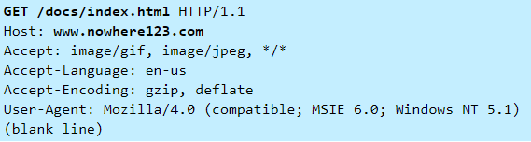
HTTP message format
# HTTP request message:

Slide 13
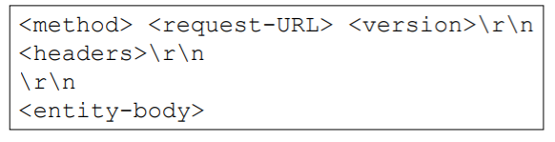
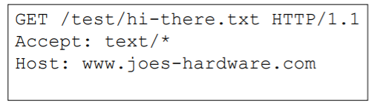
HTTP Request message format
<method> is the operation to perform on URL
<request-URL> can be full URL or just the path part
<version> is of the form HTTP/<major>.<minor>
<entity-body> is a stream of bytes (could be empty)

Slide 14
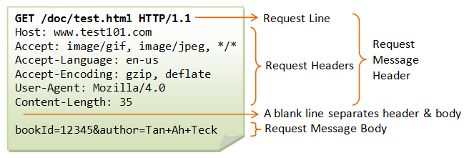
HTTP Request Headers
Host: www.joes-hardware.com
– Host from the request URL
User-Agent: Mozilla/4.0
– Client application making the request
Accept: text/html, text/xml
– MIME types the client can handle
Referer: http://www.joes-hardware.com/index.html
– Page that contained the link currently being requested
If-Modified-Since: Tue, 3 Oct 1974 02:16:00 GMT
– Conditional request; only send the document if it changed since I last retrieved it

Slide 15
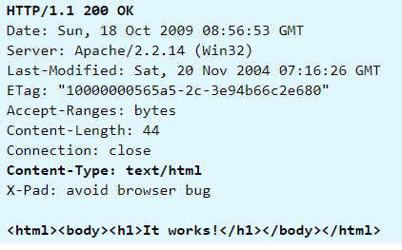
HTTP message format
# HTTP response message:

Slide 16
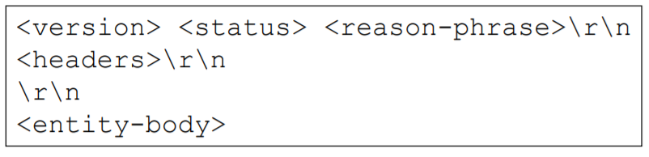
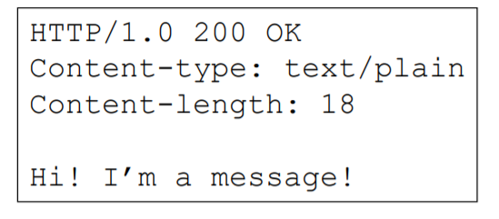
HTTP Response message format
<version> is of the form HTTP/<major>.<minor>
<status> is a 3-digit number indicating status of request
<reason-phrase> human-readable description of status code
<entity-body> is a stream of bytes (could be empty)

Slide 17
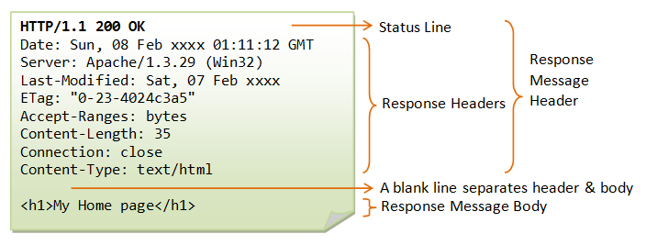
HTTP Response Headers
Content-length: 15023
– Length of response entity body measured in bytes
Content-type: text/html
– MIME type of response entity body
Server: Apache/1.2b6
– Server software that handled the request
Cache-Control: no-cache
– Clients must not cache the response document

Slide 18

HTTP Request Methods
GET – Retrieve document from server
PUT – Store document on server
DELETE – Remove document from server
POST – Send data to server for processing
HEAD – Retrieve document headers from server
OPTIONS – Determine what methods the server supports
TRACE – Trace the path taken by a request through proxy
servers on the way to the destination server

Slide 19

HTTP Response status codes
100-199 Informational
200-299 Successful
300-399 Redirection
400-499 Client error
500-599 Server error
200 OK
502 Bad Gateway
401 Unauthorized to access resource
404 Requested resource does not exist

Slide 20


Persistent Connection
Client initiates TCP Connection
Server Accepts Connection
Client sends HTTP Request Message
Sender Receives Request,
Sends Responde Message
Client Receives Response,
Finds 10 more references
Repeat 10x
Server Closes TCP Connection

Slide 21
Non-Persistent Connection
Client initiates TCP Connection
Server Accepts Connection
Client sends HTTP Request Message
Sender Receives Request,
Sends Responde Message
Client Receives Response,
Finds 10 more references
Server Closes TCP Connection
Repeat 10x

Slide 22
Persistent Connection
1
3
Network congestion is reduced by reducing the number of packets
caused by TCP opens
2
By opening and closing fewer TCP connections, CPU time is saved
in routers
and hosts
much more efficiently, with much lower elapsed time.
4
Reuse open connection

Slide 23



Method types
HTTP/1.0:
HTTP/1.1:
GET
POST
HEAD
GET, POST, HEAD
PUT
asks server to leave requested object out of response
uploads file in entity
body to path specified
in URL field
DELETE
deletes file specified in
the URL field

Slide 24
HTTP Cookies
HTTP allows the server to store a small amount of state on
the client
Each request from the client to the server contains the state
previously stored by that server on the client
This way the server can “remember” who the client is and
something about them

Slide 25
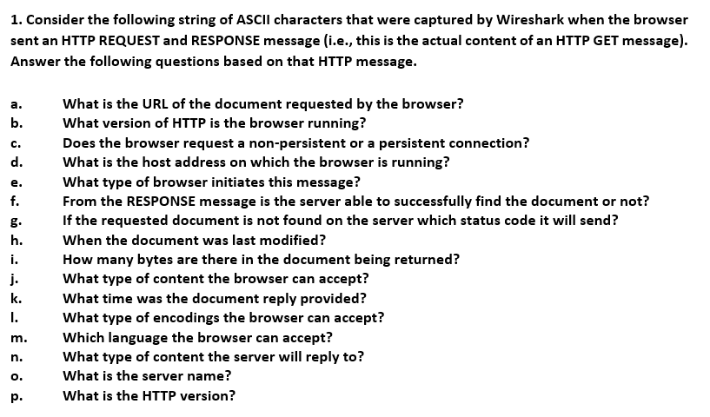

Related Questions

Slide 26
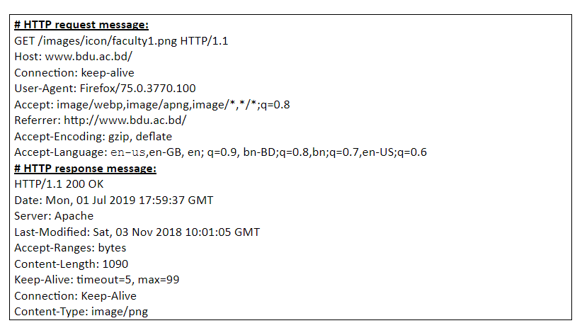
Related Questions

Slide 27
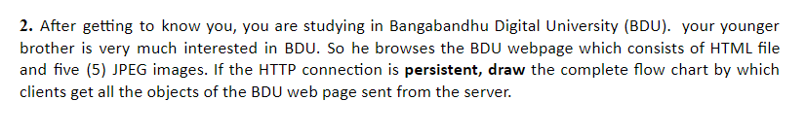
Related Questions

Slide 28
Thank you for your time.

